Slide 1

What's New in Visual Studio 2010 Debugging
Brian Peek
Senior Consultant, ASPSOFT, Inc.
Microsoft MVP - C#
http://www.brianpeek.com/
Twitter: @BrianPeek
Level: Intermediate

Slide 2
Agenda
New UI features
  Call Hierarchy
  Sequence Diagrams
  Dependency Graphs
  Variable Pinning
  Breakpoint Enhancements
Output Window
WPF Tree Visualizer
Parallel Tasks / Stacks / Threads
IntelliTrace / Historical debugging
Not going to have a lot of slides, but will demonstrate each item live

Slide 3
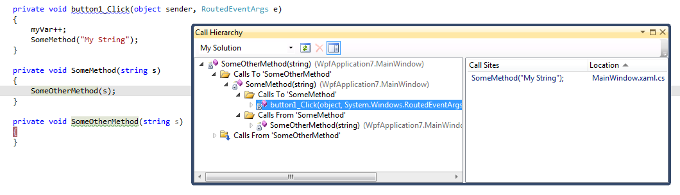
Call Hierarchy
Available on context-menu at all times
View calls to/from methods and navigate to locations

Slide 4
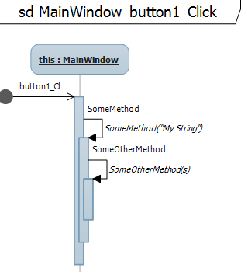
Sequence Diagrams
Available on context-menu at all times
Diagram of call structure

Slide 5
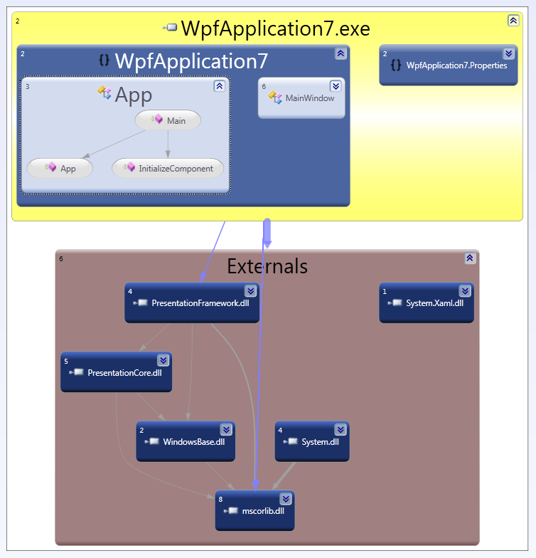
Dependency Diagrams
Available in VS2010 Ultimate only
Architecture -> Generate Dependency Graph

Slide 6
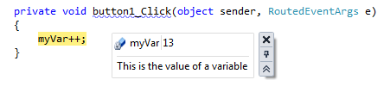
Pinning
Pin variables to the IDE
  Add comments
  Edit values
  Saved across sessions
  Last value shown at next session
  Can be imported and exported

Slide 7
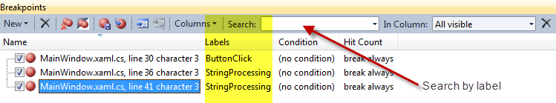
Breakpoints
Breakpoints can now be named and grouped
Breakpoints can be imported and exported

Slide 8
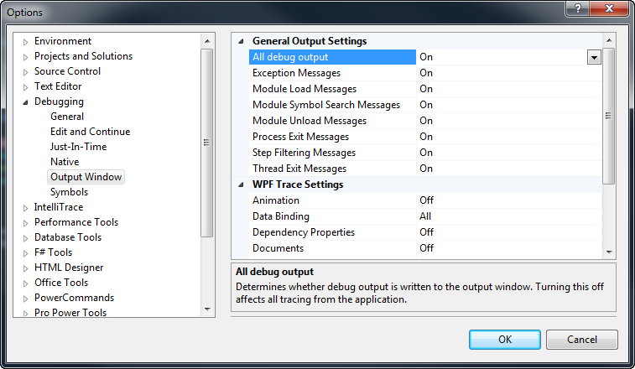
Output Window
IDE now allows setting levels of output for specific bits of information

Slide 9
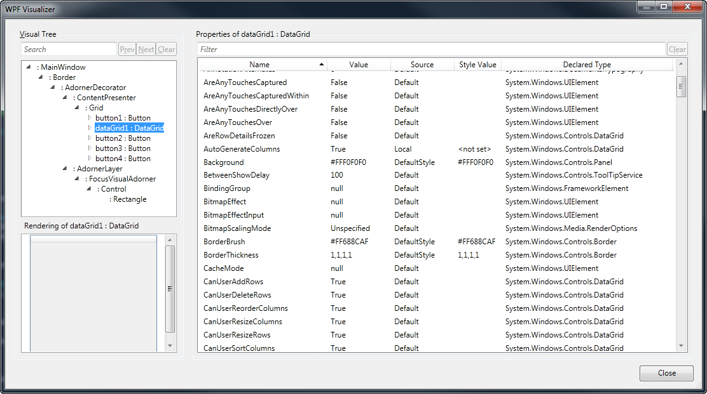
WPF Tree Visualizer
Use the standard magnifying glass icon in a watch window on the WPF item

Slide 10
Multiple Monitors
Drag any window (debugger, editor, etc.) out of the IDE and place it on any monitor
Windows are easily re-docked back into IDE

Slide 11
Parallel Stacks
Parallel Stacks window shows currently executing threads and tasks in the application
Shows graph of executing threads as well as call stacks for each thread
This window can be used in conjunction with the standard Threads and Call Stack window to get additional information, or you can drill down from this window for call stack info
Blue highlight shows path of current task/thread

Slide 12
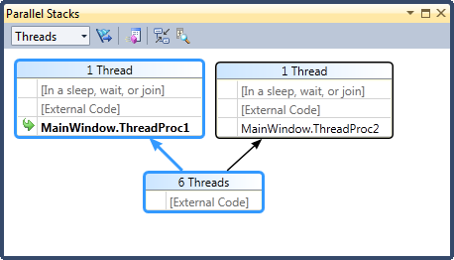
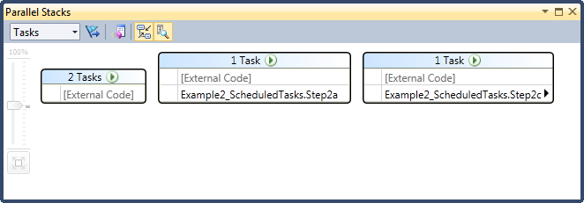
Parallel Stacks

Slide 13
Parallel Tasks
When using the new Task Parallel Library additions to .NET4, this window will show currently executing Tasks, their running status, the owning thread, and tons of other information
Threads can be frozen
Ability to “flag” tasks and interact with in Parallel Stacks window

Slide 14
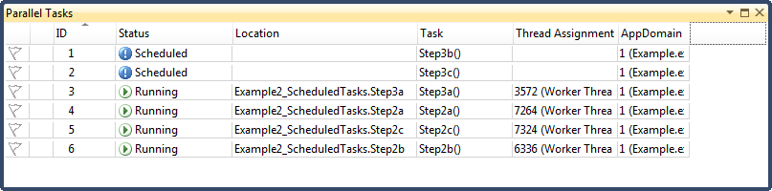
Parallel Tasks

Slide 15
IntelliTrace (Historical Debugging)
Only available in VS2010 Ultimate
Creates tracing logs which can be viewed in IDE showing application execution
Inspect variables during the process
Run through debugger as though it were executing through your machine directly
32-bit / x86 ONLY!!

Slide 16
IntelliTrace
Latest Azure SDK supports deploying services with IntelliTrace enabled
Microsoft Test Manager and VS2010 Unit tests can use IntelliTrace
If you want to use on a machine without VS2010, requires some extra hacking that isn’t supported (and perhaps not licensed…)
  Great post by Naveen Srinivasan:
    http://tinyurl.com/intellitracehack

Slide 17
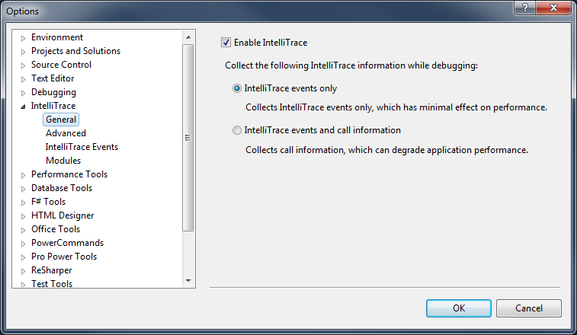
Configuring IntelliTrace
IntelliTrace can be configured from the standard Tools -> Options dialog
Different levels of tracing available
  By default, traces specific IntelliTrace Events only
  Can turn on “call information”, but much slower
  Can specify exactly what events are traced or ignored
  Can also specify what modules are traced or ignored

Slide 18
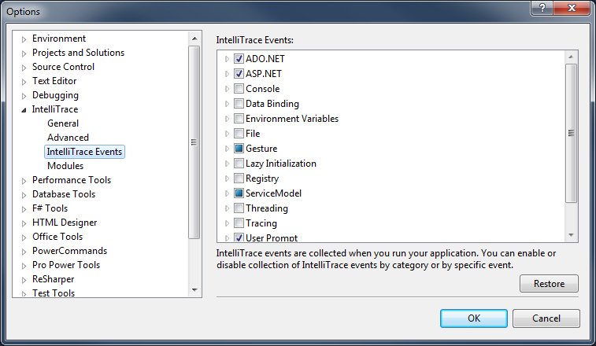
Configuring IntelliTrace
Fine-grained control over which events are collected

Slide 19
Using IntelliTrace
Run your application in debug mode in VS
When breakpoint is hit or debugging is paused, view the IntelliTrace tab for what events have been collected since the start of the debug session
Pull out interesting data like executed SQL automatically, even with LINQ
Search for a specific line of code
Navigate through code with icons in editor gutter
View local variables in each method

Slide 20
Using IntelliTrace
By loading an IntelliTrace “iTrace” file, you can view and use IntelliTrace information directly
These are stored on the local hard drive at location specified in configuration, or can be attached to bugs when using Test Manager and TFS

Slide 21
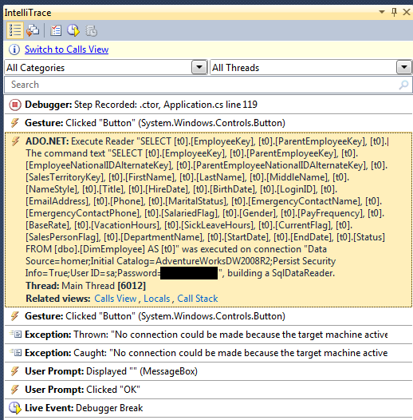
IntelliTrace Sample Output

Slide 22
Links
Me
  http://www.brianpeek.com/
Slides
  http://www.brianpeek.com/events/
New debugging features
  http://tinyurl.com/vs2010newdebug
MSDN Article on IntelliTrace
  http://tinyurl.com/msdnintellitrace
Information on Parallel debugging
  http://www.danielmoth.com/

